Slide 1
MANAGING FILES FROM THE COMMAND LINE

Slide 2
Aim: To copy, move, create, delete, and organize files while working from the Bash shell prompt

Slide 3
The Linux File System Hierarchy
All files on a Linux system are stored on file systems which are organized into a single inverted tree of directories, known as a file sys tem hierarchy.
This tree is inverted because the root of the tree is said to be at the top of the hierarchy, and the branches of directories and subdirectories stretch below the root.

Slide 4
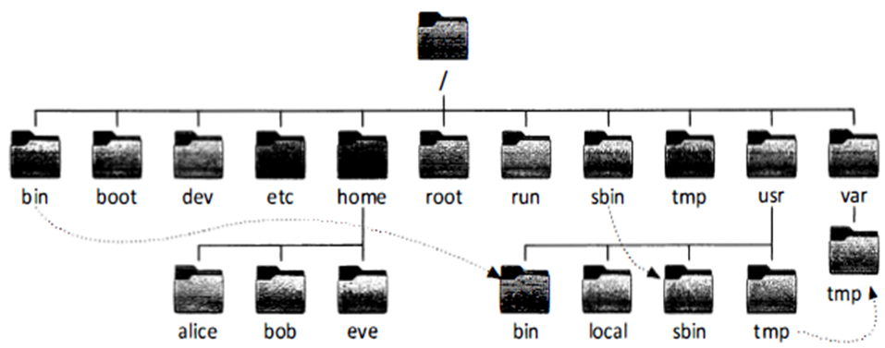

Slide 5
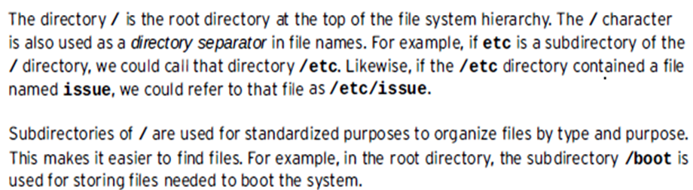

Slide 6
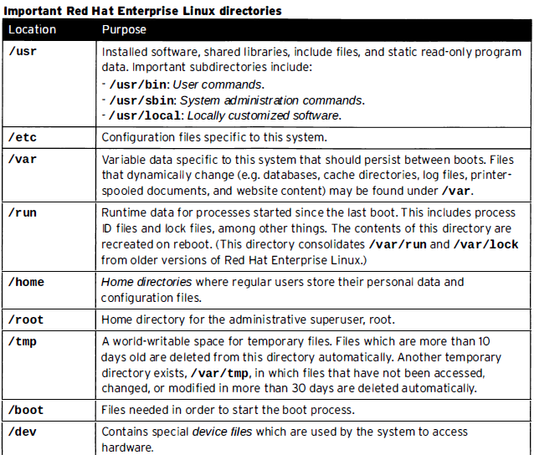

Slide 7
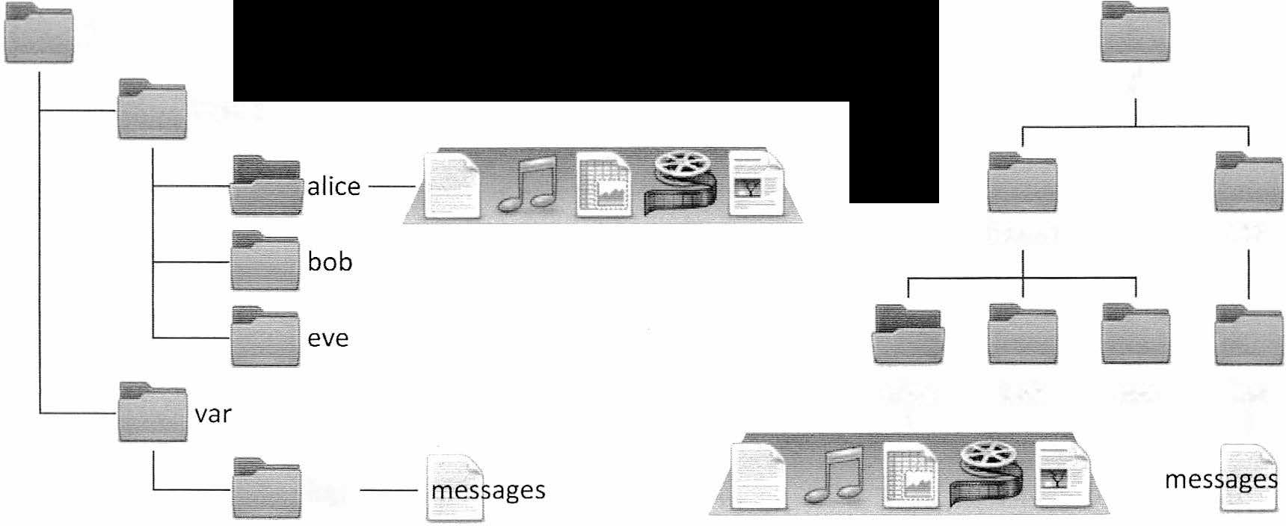
Locating Files by Name

Slide 8
Navigating paths
The pwd command displays the full path name of the current location , which helps determine appropriate syntax for reaching files us ingrelative pathnames.
The ls command lists directory contents for the specified directory.
The two special directories at the top of the listing refer to the current directory ( . ) and the parent directory ( . . )

Slide 9
Navigating paths
cd - : will print the path and will redirect to parent directory
Is - I ~ : List the current user’s home directory (long format)
in simplest syntax , when it is not the current location.
c d . . / . . : Move up two levels from the current location .

Slide 10
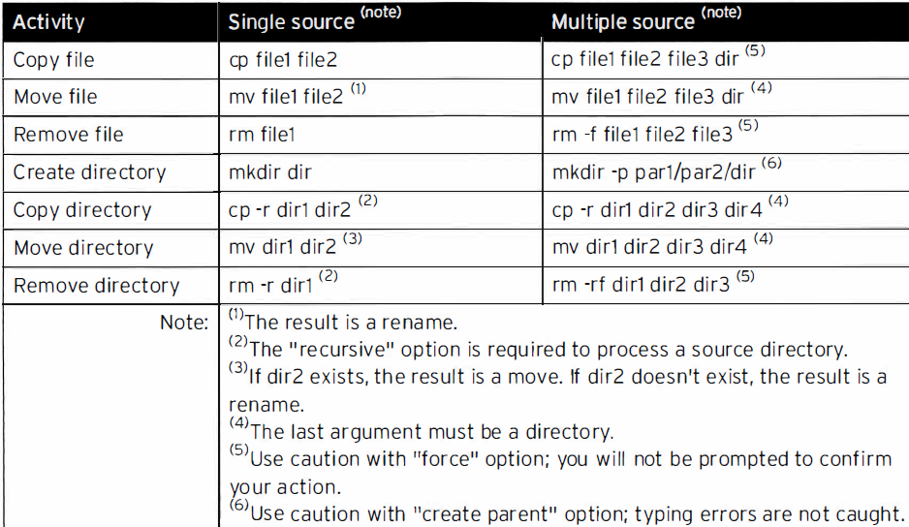
Managing Files Using Command - Line Tools

Slide 11
Create directory
The mkdir command creates one or more directories or subdirectories , generating errors if the file name already exists or when attempting to create a directory in a parent directory that doesn’t exist.
The -p parent option creates missing parent directories for the requested destination. Be cautious when using mkdir - p, since accidental spelling mistakes create unintended directories without generating error messages.

Slide 12
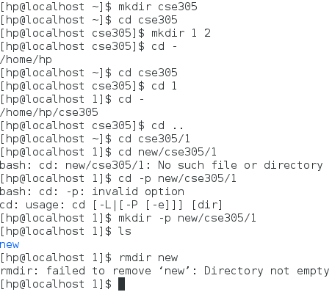
mkdir

Slide 13
cp: Copy Content
When copying multiple files with one command, the last argument must be a directory. Copied files retain their original names in the new directory. Conflicting file names that exist at a destination may be overwritten.
Copying non-empty directories, with contents, requires the -r recursive option

Slide 14
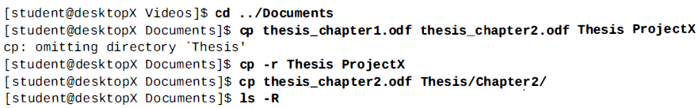
cp: Copy Content

Slide 15
mv command
The mv command renames files in the same directory, or relocates files to a new directory.
File contents remain unchanged.
Files moved to a different file system require creating a new file by copying the source file, then deleting the source file.

Slide 16
Remove files and directories
rmdir
rm –r
rm

Slide 17
Matching File Names Using Path Name Expansion
File globbing: path name expansion
The Bash shell has a path name - matching capability called globbing.
Uses pattern matching or " wild cards "

Slide 18
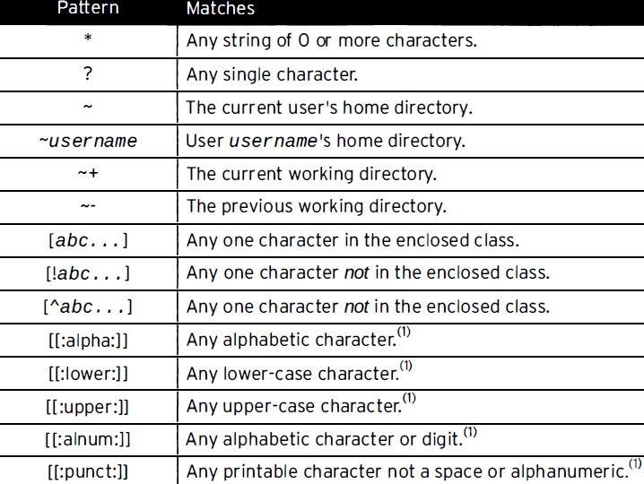
Matching File Names Using Path Name Expansion

Slide 19
Linux File Globbing
Globbing is also known as path name expansion.
To learn about file globbing, we need to know about wildcards.
Wildcards patterns are the strings containing characters like '?', '[', '*’.
It performs action on more than one file having same pattern or to find part of a phrase in a text file.
Shell uses wildcards for file globbing.
Globbing is an operation that recognizes the wildcard pattern and expands it into its path name.

Slide 20
Linux File Globbing
1. *asterisk
It matches the combination by any number of characters.
2. ? question mark
You can also use question mark sign in place of asterisk to generate matching file names. It is placed at the end of a line. It matches the combination by exactly one character.
3. [] Square Brackets
Square brackets are also used to generate matching file names inside the brackets and the first subsequent. Order inside the square bracket doesn't matter. It matches the combination by exactly one character.
ls new[12]

Slide 21
Linux File Globbing
4. ! exclamation mark
The exclamation mark excludes characters from the list within the square bracket. And you can use the combination of asterisk (*), question mark (?) and square bracket [].
ls new[!2]?
5. Ranges [a-z] and [0-9]
You can also specify ranges according to your need.
ls new[a-z]*

Slide 22
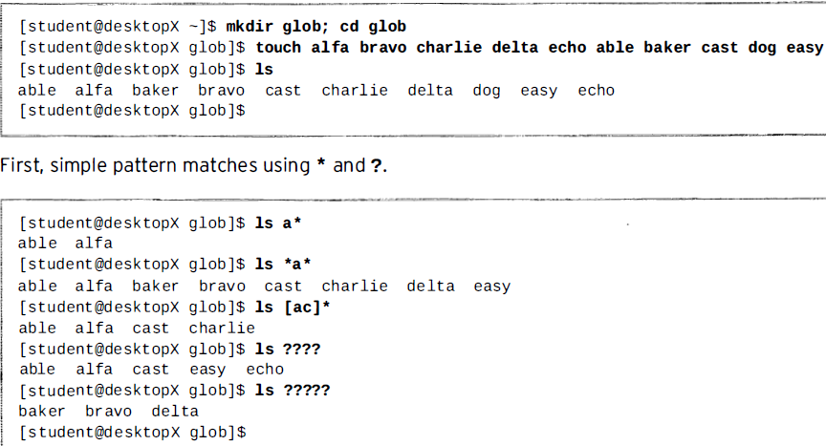
Wild cards

Slide 23
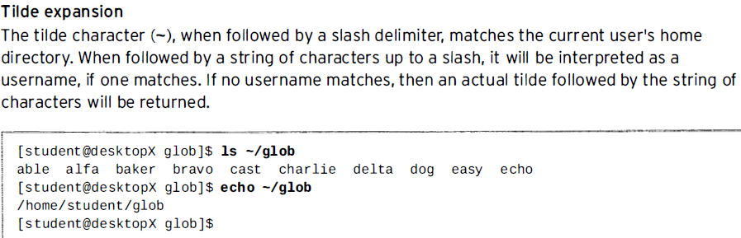
Tilde Expansion

Slide 24
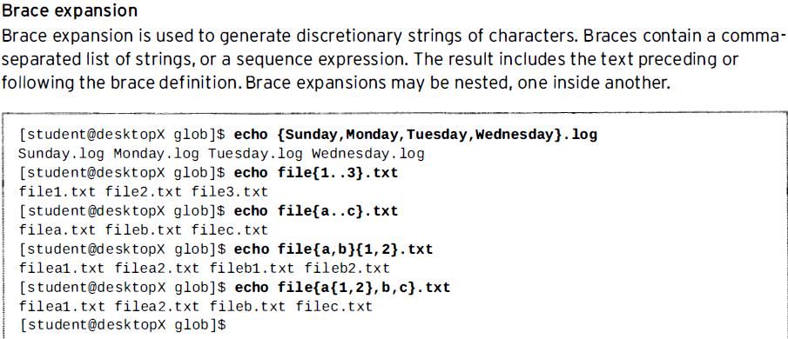
Brace Expansion

Slide 25
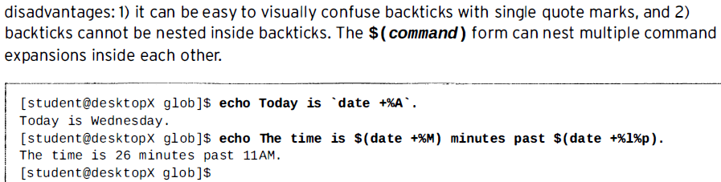
Command substitution

Slide 26
Locating Files by Name
use the find command
Syntax of a basic find command:
find /path option filename
Find by name

